Slide 1
Earth’s Geologic History based on fossils
By:

Slide 2
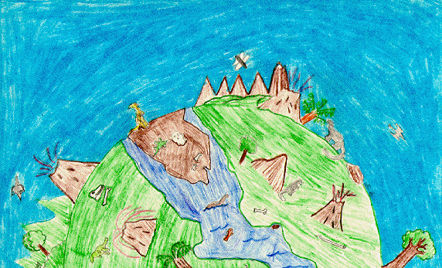
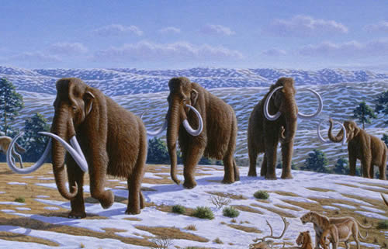
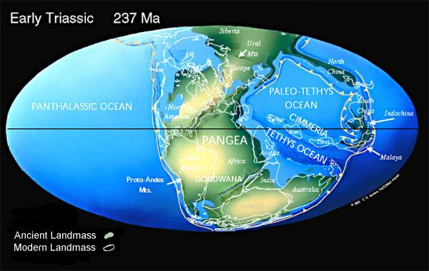
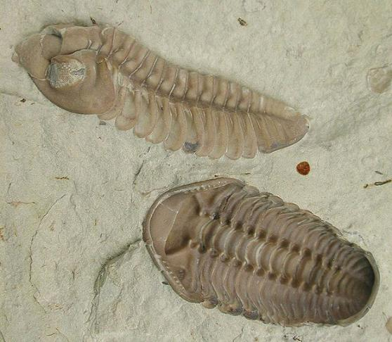
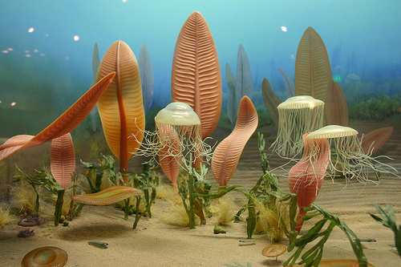
JURASSIC PERIOD (6 – 24 million years ago)

Slide 3
Cenozoic Era Today -____ million years ago

Slide 4
Quaternary Period Today to 1.8 million years ago (MYA)

Slide 5
Tertiary Period 1.8 MYA – _____ MYA

Slide 6
Mesozoic Era 66 - _____ million years ago

Slide 7
Cretaceous Period 66 – 144 MYA

Slide 8
Jurassic Period 144 – ______ MYA

Slide 9
Triassic Period ______ – 245 MYA

Slide 10
Paleozoic Era 245 - _____ million years ago

Slide 11
Permian 245 - ______ MYA

Slide 12
Carboniferous 286 – 360 MYA

Slide 13
Devonian 360 - ______ MYA

Slide 14
Silurian ______ - ______ MYA

Slide 15
Ordovician ______ – 505 MYA

Slide 16
Cambrian 505 - ______ MYA

Slide 17
Precambrian Time (Era) _____ million years ago – 4.6 Billion years ago

